Slide 1
HealthNCare App V1.0
Team Charlie
Zaher Asad, Allan Flores, Alfred Franco, Ethan Gapay, Alex Tedesco, & Nolan Wira
Notes:
Ethan

Slide 2
TABLE OF CONTENTS
01
DESIGN APPROACH/RATIONALE
04
LIMITATIONS AND DISCLAIMERS
02
TEAM DYNAMICS/CHALLENGES
05
CONCLUSION
FEATURE DEMO/FUNCTIONALITY
Q&A
03
06
Identification of project limitations and disclaimers about functionality.
Explanation of our design decisions and reasoning.
Recap of key points and next steps in the project.
Insights into team collaboration.
Brief demo showcasing project features and functionality.
Open Q&A session.
Notes:
Ethan

Slide 3
Design Approach & Rationale
01
Notes:
Ethan

Slide 4
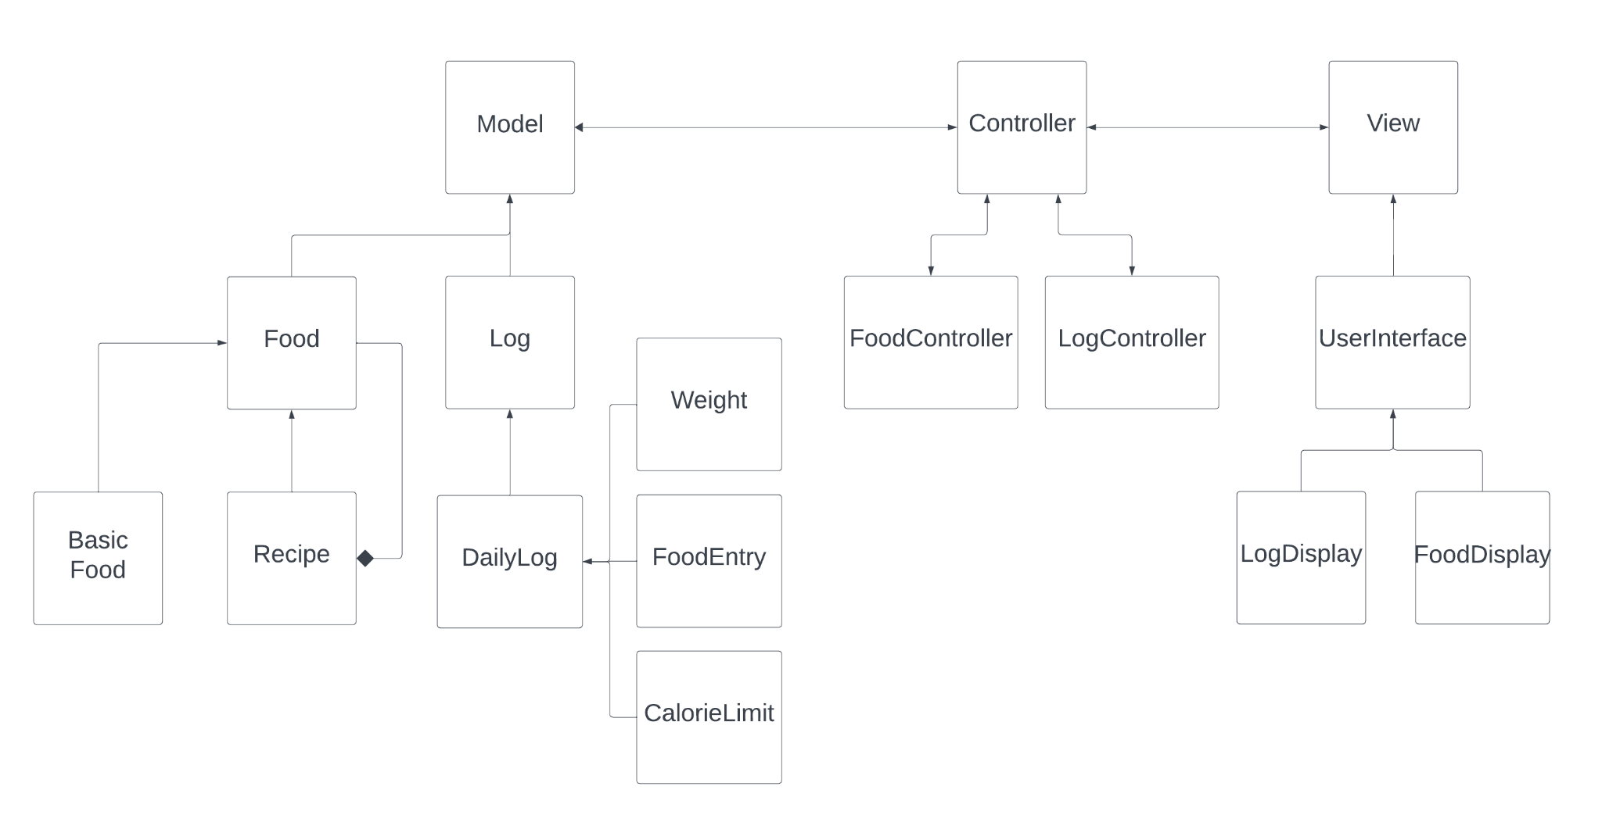
Domain Diagram
Notes:
Ethan

Slide 5
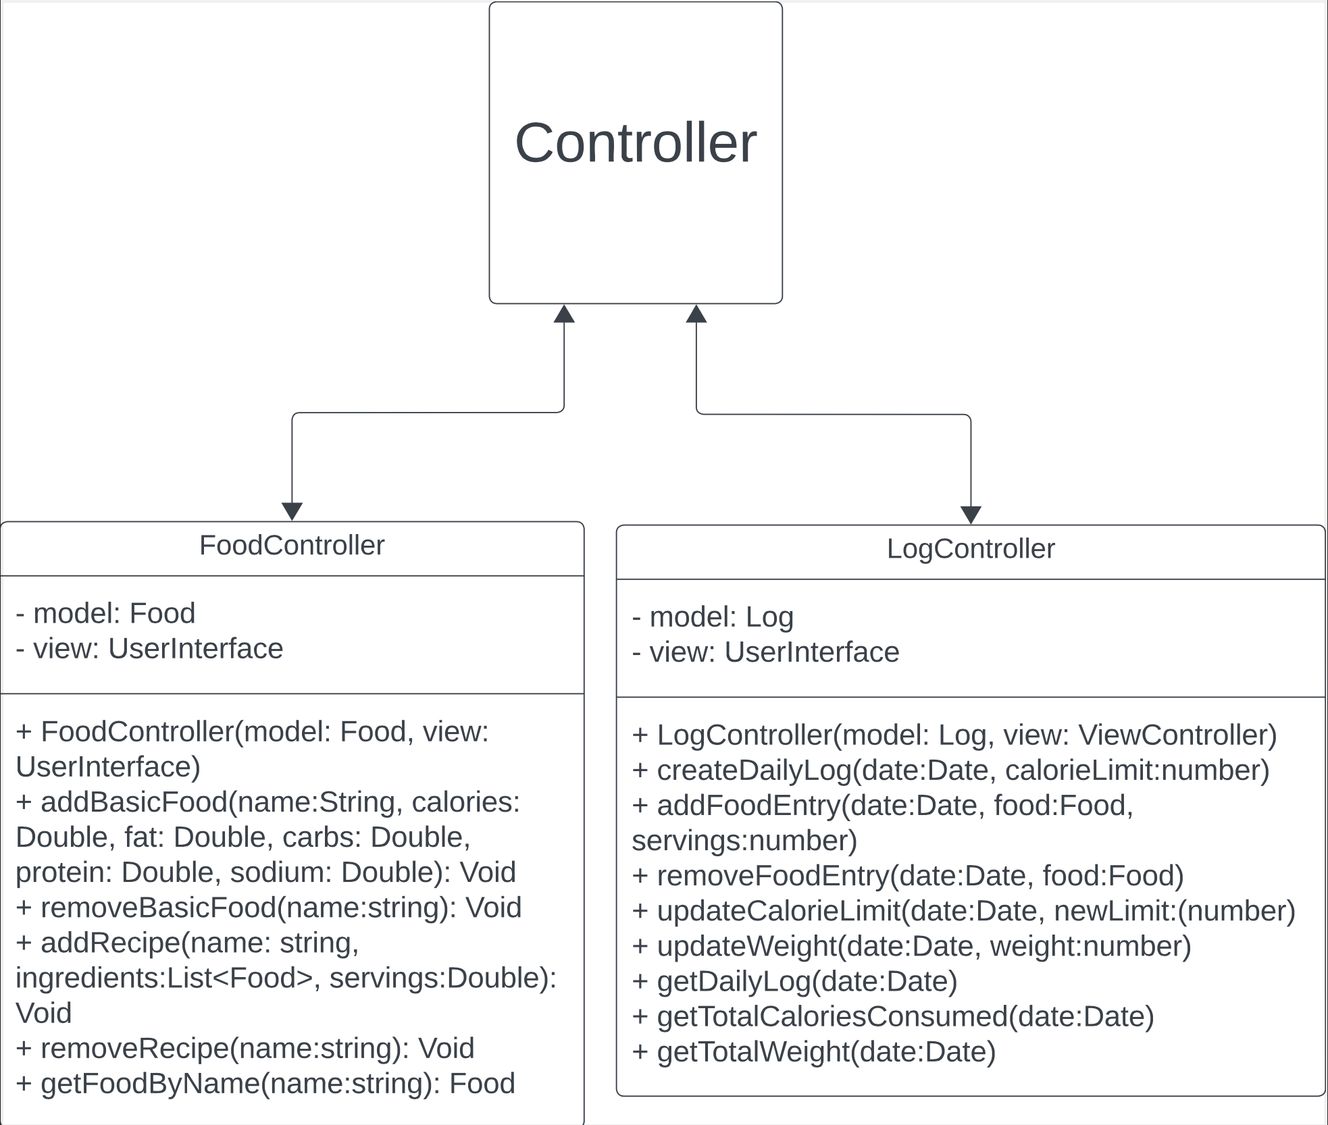
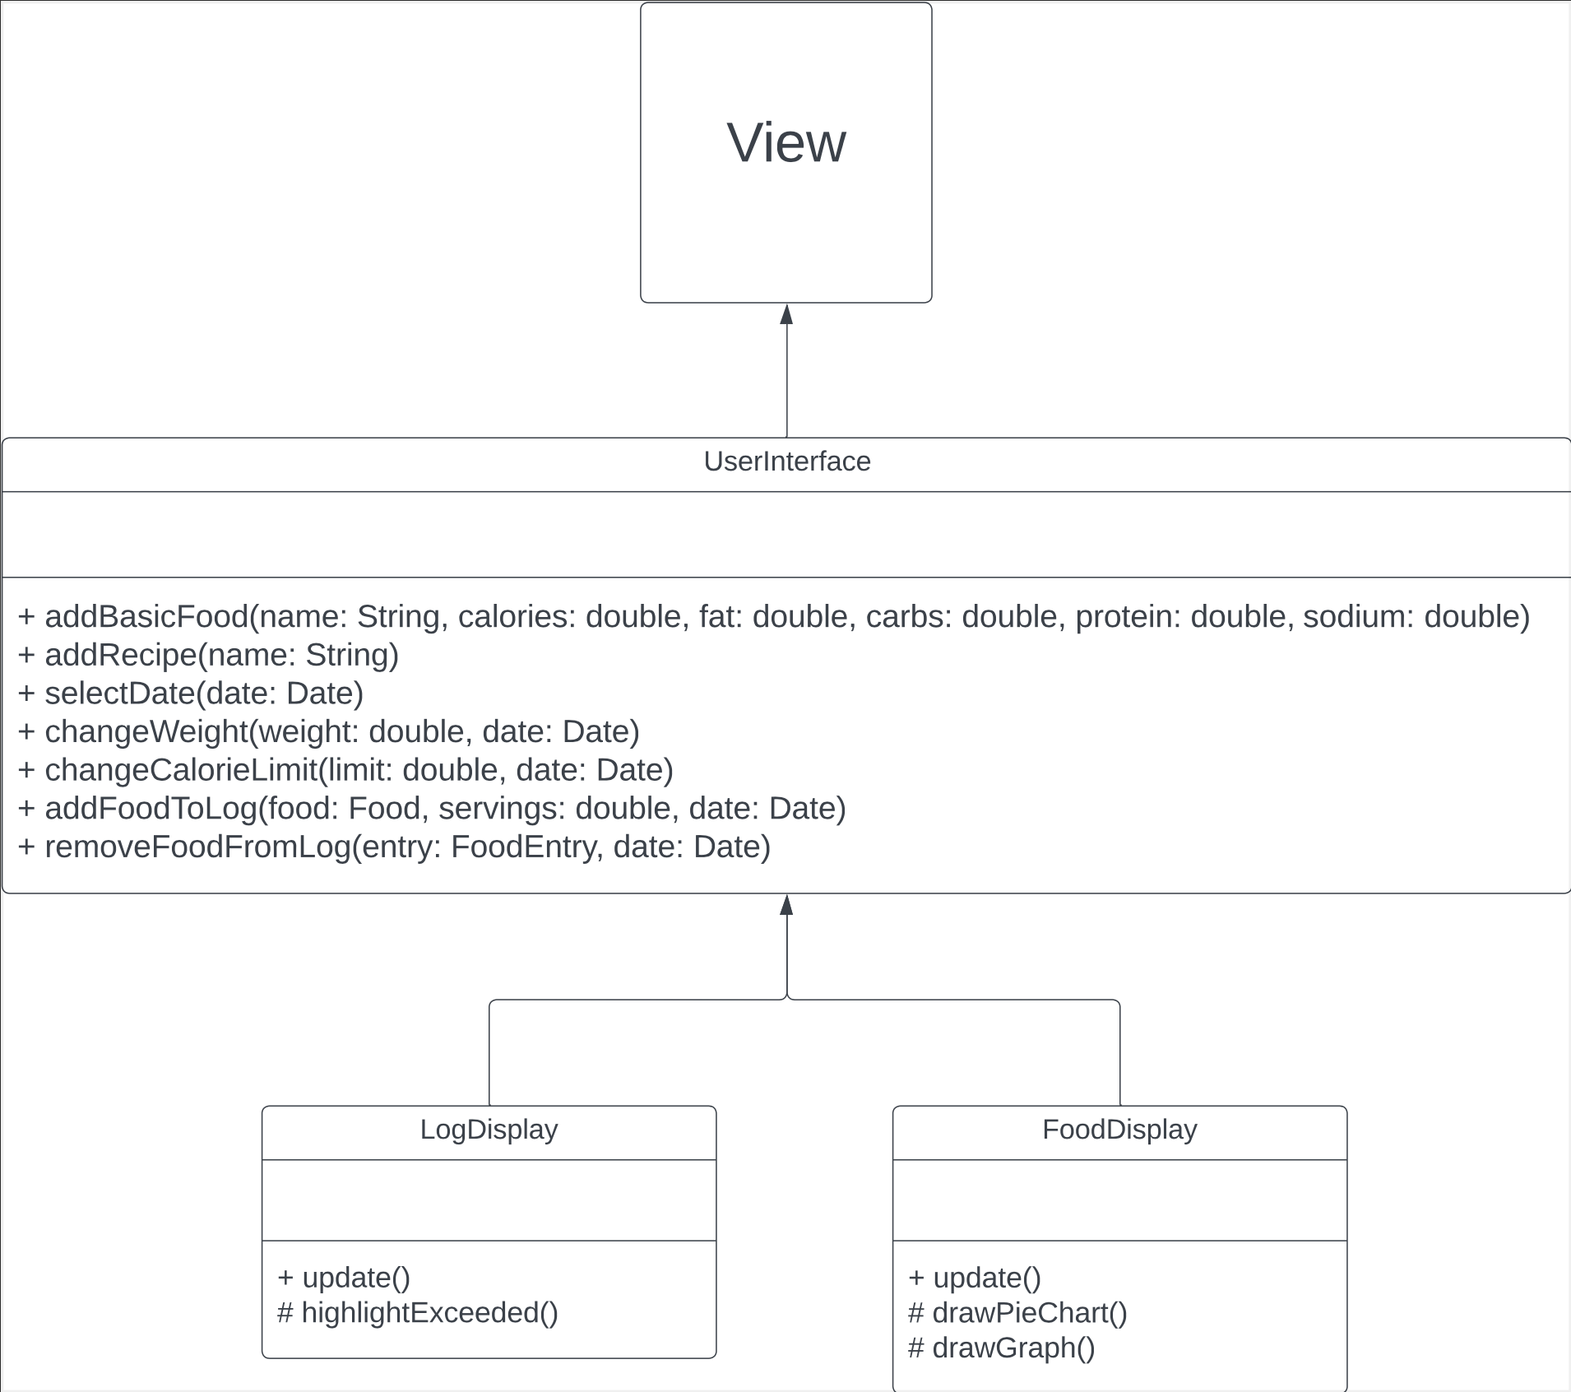
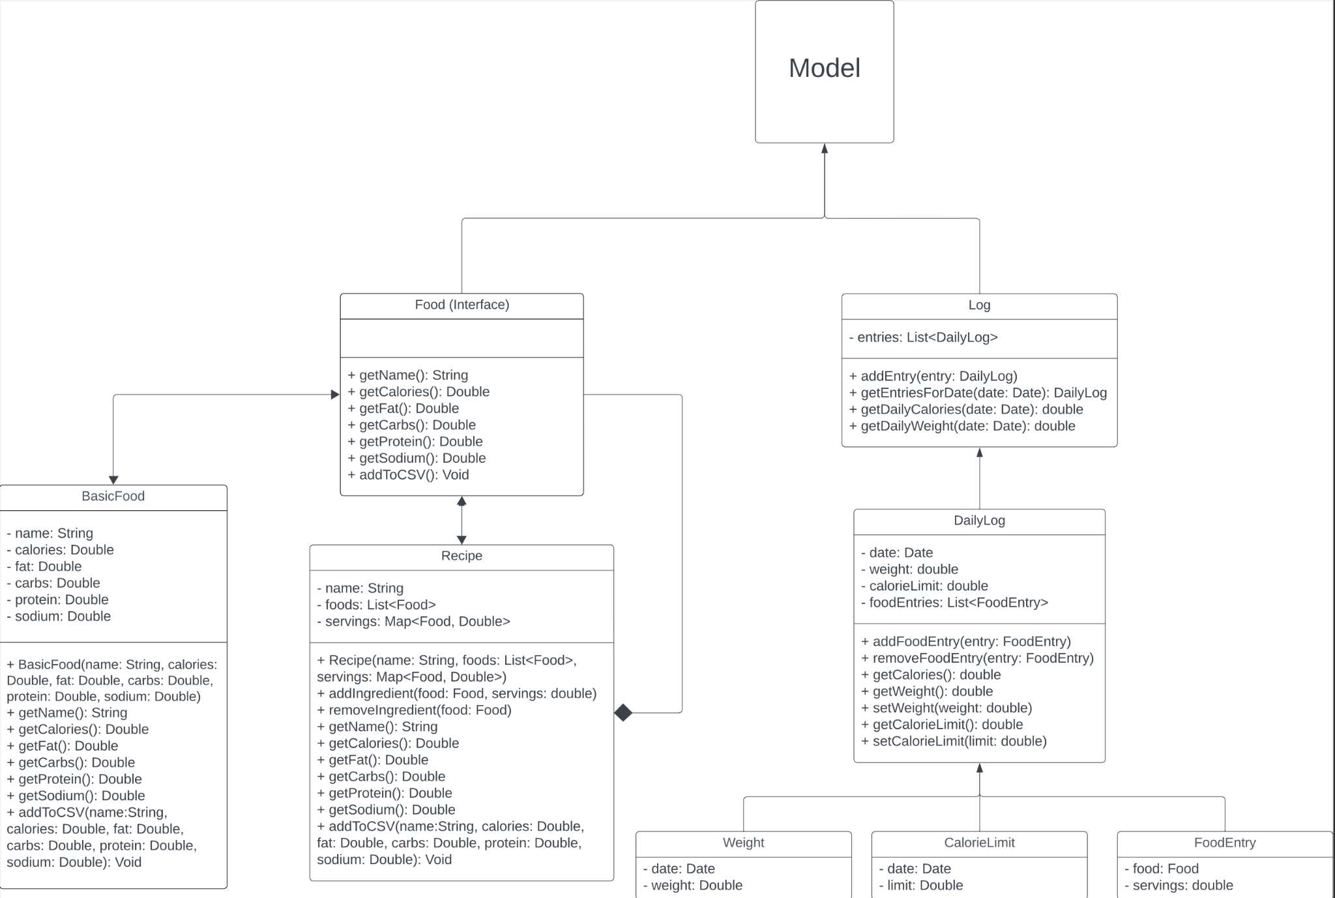
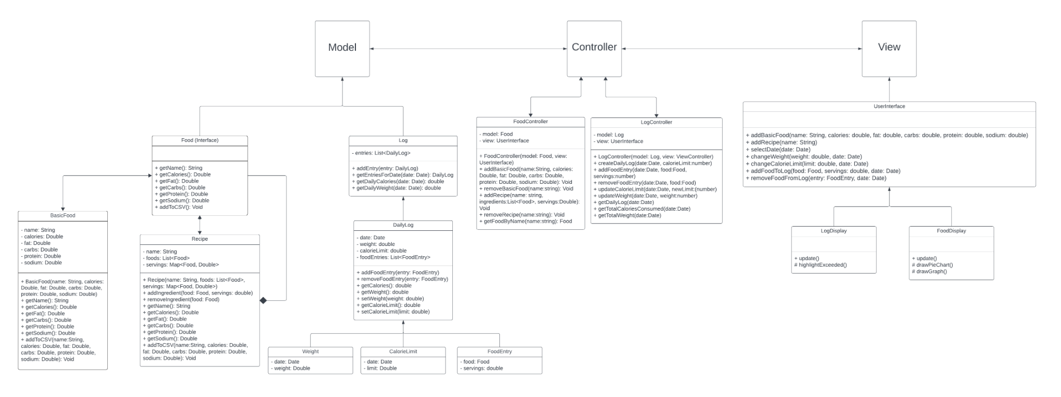
Class Diagram
Notes:
Zaher

Slide 6
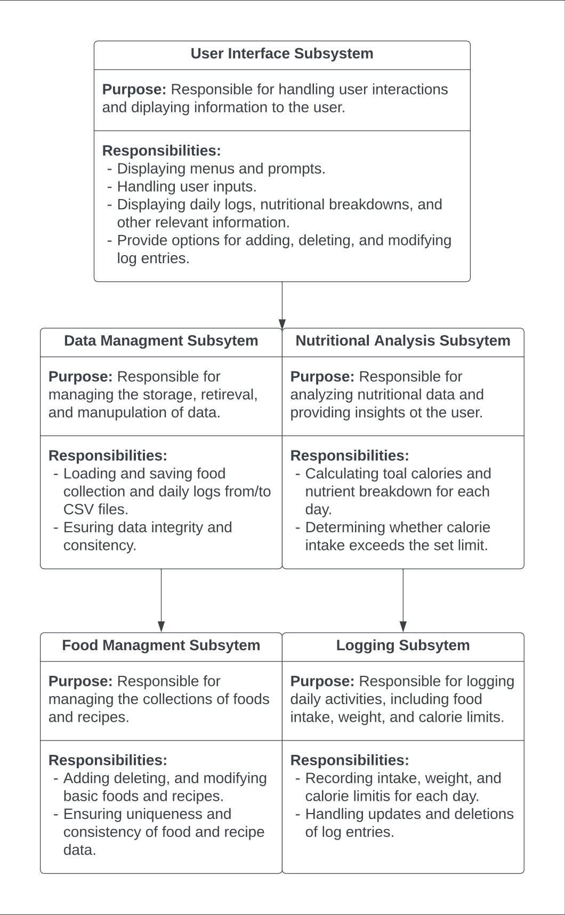
Subsystem Structure
Notes:
Zaher

Slide 7
Team Dynamics & Challenges
02
Notes:
Zaher

Slide 8
Team Dynamic
 | ROLE | DESCRIPTION | RESPONSIBILITIES
Zaher Asad | UI/UX Designer & Frontend Developer | Responsible for creating the visual and interactive elements of the HealthNCare application | - Develop design mockups for the app interface. - Implementation of the user interface design.
Allan Flores | Backend Developer | Responsible for implementing certain data structures. | - Developed the Food subsystem alongside Alfred.
Alfred Franco | Backend Developer | Responsible for file implementation | Developed logic for writing to files using relative paths and worked on food subsystem with Allen
Ethan Gapay | Backend Developer | Responsible for handling controller portion of application | - Develop controller classes for log and food - Implement classes to handle functionality between model and view
Alex Tedesco | Frontend Developer | Responsible for developing client side CLI applications | - Develop the command line interface of the HealthNCare application - Improve controller logic (as needed)
Nolan Wira | System Architect / Designer & Software Engineer | Responsible for system architecture design - class & sequence diagrams, Assisted on code, Phase 1 Presentation | - Create most of class diagram with all the attribute & methods. - Assisted on Code Phase 1 Presentation
Notes:
Nolan

Slide 9
Challenges
Successes
Difficulty in determining the appropriate classes and structures within the codebase.
Complexities in defining the application architecture to meet project requirements.
Challenges in distributing workload evenly among team members.
Maintaining effective communication and collaboration in remote or distributed team settings.
Effective collaboration leads to consensus on project decisions.
Clear communication ensures alignment on project goals and tasks.
Consistently meeting deadlines for project deliverables.
UML Design Sketch
Regular progress updates and milestones achieved contribute to project success.
Notes:
Nolan

Slide 10
HealthNCare V1.0 Demo
03
Notes:
Alex

Slide 11
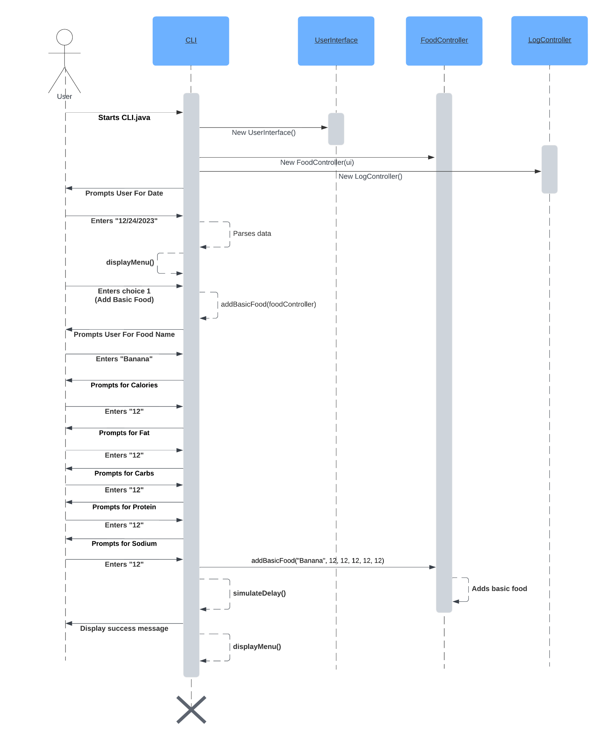
Demo Sequence Diagram
Notes:
Alex

Slide 12
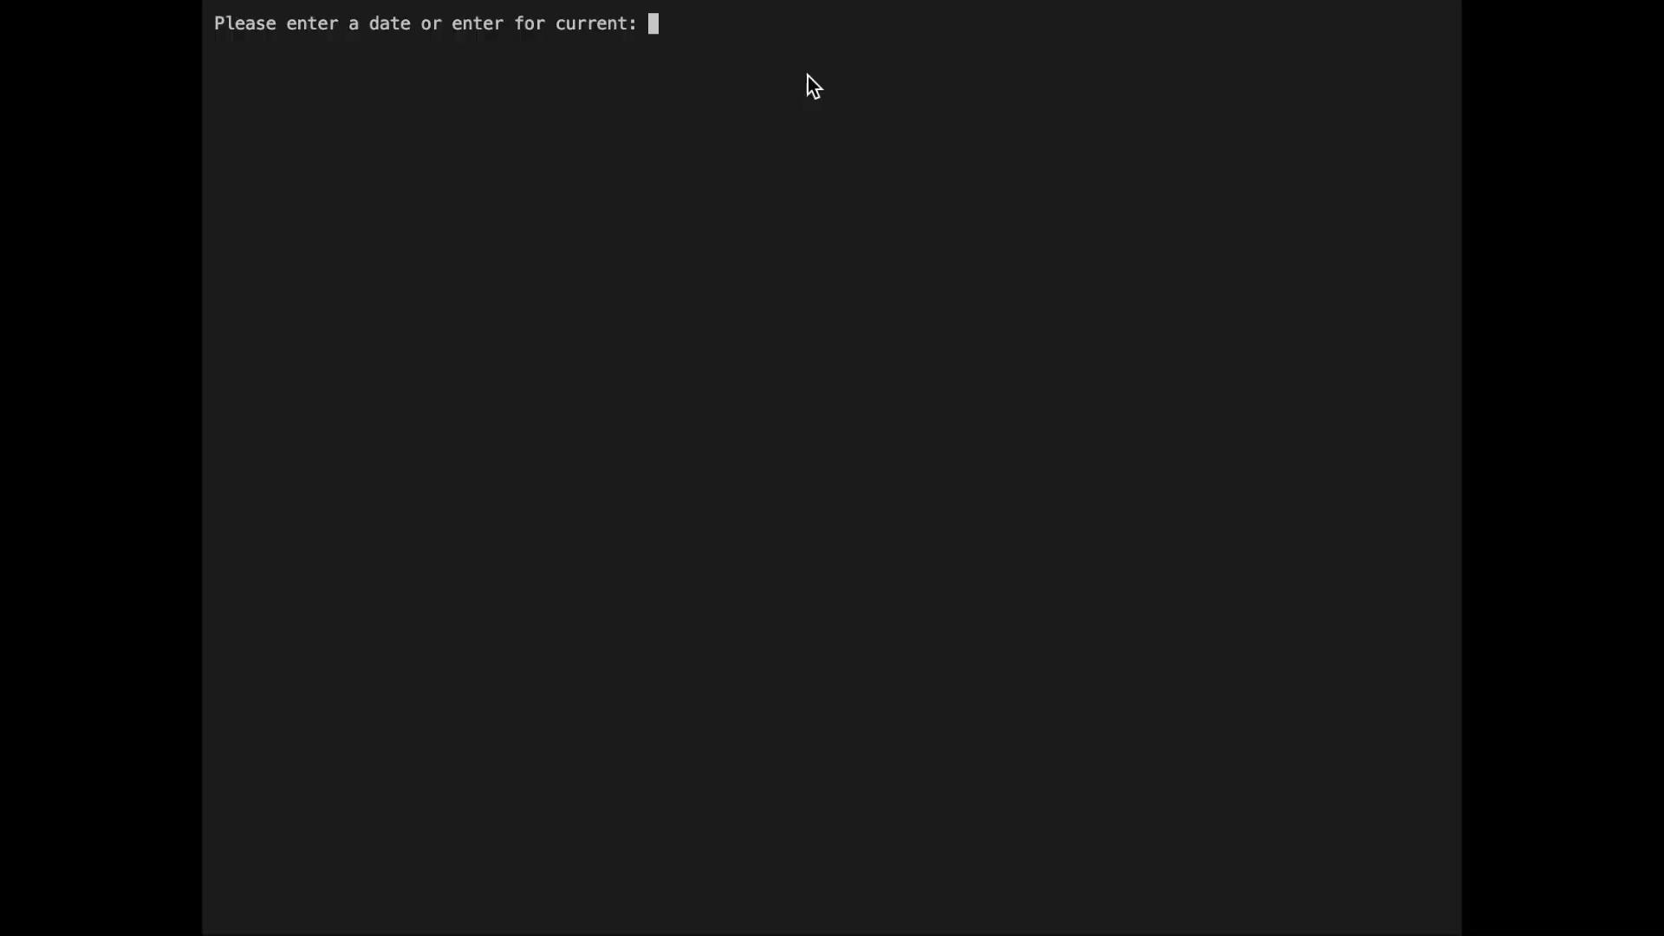
Notes:
Alex

Slide 13
Limitations & Disclaimers
04
Notes:
Alfred

Slide 14
Limitations
Disclaimers
The app's recommendations and insights are based on general nutritional guidelines and may not account for individual health conditions or specific dietary needs.
Data privacy and security measures have been implemented but may have room for further enhancement in future versions.
The user interface is functional but additional design refinements and usability optimizations can be made in subsequent releases.
The HealthNCare app is intended as a general wellness tool and does not replace professional medical advice, diagnosis, or treatment. Always consult with a qualified healthcare provider for personalized health guidance.
While efforts have been made to provide accurate nutritional information, the app relies on third-party databases and user-provided data, which may not be entirely comprehensive or error-free.
Users are responsible for ensuring the accuracy and completeness of their logged data. The app's insights and recommendations are only as reliable as the information provided by the user.
Notes:
Alfred

Slide 15
05
Conclusion
Notes:
Alfred

Slide 16
Conclusion
Key Points:
Next Steps:
The HealthNCare app V1.0 provides users with a tool to log and track their nutritional intake and exercise.
The app offers insights and recommendations based on the user's logged data to support their wellness goals.
The development team successfully collaborated to design and implement the app's architecture and key features.
Limitations and disclaimers were identified to set appropriate expectations for users and highlight areas for future enhancements.
Gather user feedback and conduct usability testing to identify areas for improvement in future versions.
Implement additional features and functionalities based on user feedback and evolving requirements.
Enhance the app's data privacy and security measures to ensure the protection of user information.
Refine the user interface design and user experience to provide a more intuitive and engaging app interaction.
Explore integration opportunities with other health and fitness platforms to expand the app's ecosystem.
Plan for the development and release of HealthNCare App V2.0 with the incorporation of new features and enhancements.
Notes:
Allan

Slide 17
06
Questions?
Notes:
All

